Slide 1
Docker: Application Containerization

Slide 2

Agenda
What is Docker?
Docker Architecture
Installing Docker
Dockerfile
Docker Images
Docker and Microservices

Slide 3
What is Docker ?
Docker separates applications from infrastructure using the container technology. This is similar to the way VMs separate operating systems from the hardware. Using Docker containers, you can deploy, replicate, move, and back up a workload even more quickly and easily than you can do so using virtual machines. Docker container are highly scalable (can be expanded rapidly), portable (Dockerized application are extremely portable). Docker uses google ‘Go’ programming language for Docker development.
Docker Registries:
A registry is a storage and content delivery system, holding named Docker images, available in different tagged versions. Users interact with a registry by using Docker push and pull commands.
One can create and share Docker image on ‘Docker hub’ for sharing with co-workers, customers etc.
$ docker pull
$ docker run <container name>
Docker formerly known as dotCloud

Slide 4

Virtual Machine V/S Containers
App 1
App 1
Bins/ Libs
Bins/ Libs
App 1
App 1
App 1
App 1
Docker Engine
Bins/ Libs
Bins/ Libs
Bins/ Libs
Bins/ Libs
Guest Linux
Guest OS
Guest OS
Docker Engine
Hypervisor
Hypervisor
Host Linux
Host OS
Host OS
Hardware
Hardware
Hardware
Virtual Machine
Docker on Non-Linux
Docker on Linux / Win Server 2019 and later

Slide 5
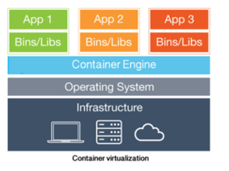

Docker Architecture
Linux Host OS
Docker client
Docker daemon
Container 1
Container 2
Container 3
Container are very light weight that shares same OS kernel, as compared to a VM.
Container still provides isolated user space like a VM. This can also be referred as container virtualization or OS level virtualization.
Container share Host OS resources like, RAM, CPU, Storage, network, etc.
Each container has its own set of file system, like /etc, /var, /opt, etc.
Container is created from a container image that can be customized. One can create a custom container image using Dockerfile that suits to your application requirements.
Containerization is based on the Linux Kernel Namespaces.

Slide 6
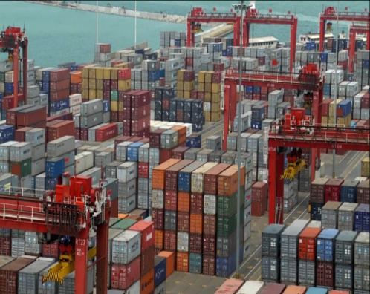
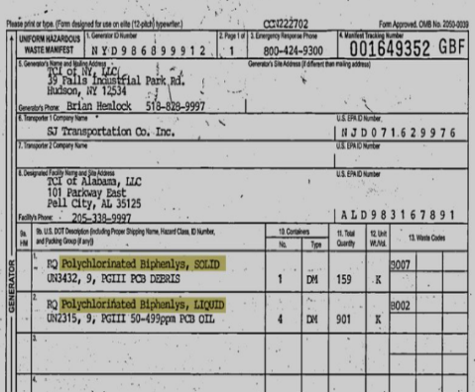
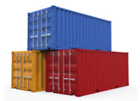
Docker High Level picture
Docker Engine
Docker Images
Docker containers
(Shipping Yard)
(Shipping Manifests)
(Shipping Containers)
While using a container from public repository, utmost care should be taken of using only trusted container as there can be malicious code in the containers.
Docker engine is also known as Docker Daemon or Docker Runtime…..

Slide 7

Installing Docker on Windows / Mac
Docker can be installed on Windows as well as Linux flavor machine.
Docker can be installed on Windows desktop OS or MAC machine using Docker-Desktop
Download Docker for windows from the URL,
https://docs.docker.com/docker-for-windows/install
https://docs.docker.com/desktop/install/mac-install/
Docker Desktop on Windows needs WSL-2 to be enabled.
$ docker version
Client: Docker Engine - Community
Version: 24.0.4
API version: 1.43
Go version: go1.20.5
Git commit: 3713ee1
Built: Fri Jul 7 14:50:57 2023
OS/Arch: linux/amd64
Context: default
Server: Docker Engine - Community
Engine:
Version: 24.0.4

Slide 8
Install Docker-CE on Linux
To, install Docker on Linux / Ubuntu OS, follow the link mentioned below.
https://docs.docker.com/engine/install/ubuntu/
For other Operating systems, follow the link below,
https://docs.docker.com/engine/install/

Slide 9

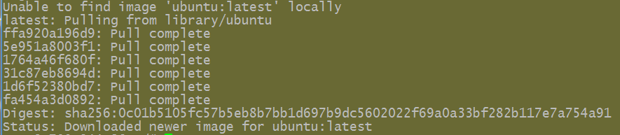
Docker commands
Now to use a docker image that is part of the docker repository, use below command,
Docker promotes the standardization ideology and so that a container created on a local machine can easily be ported to EC2, Azure or any other cloud environment.
$ docker run –it ubuntu /bin/bash ---- this tells the docker to run in interactive mode and assign a terminal, use the Ubuntu image for the container to create and then run the /bin/bash command once the container is ready.
$ docker ps –a --- this will show all processes running on the host.
$ docker start <container code> --- start the container
$ docker attach <container code> --- attach to running container
Registry
(hub.docker.com)
Docker HUB: Registries and Repository:
Repo
Image:1,2
Repo
Image:1,2
Repo
Image:1.2

Slide 10
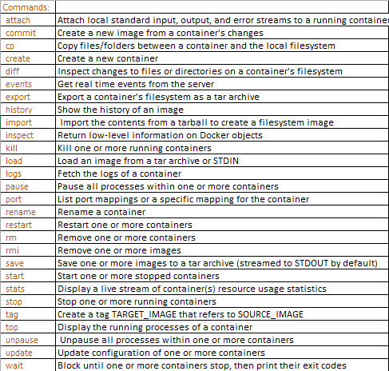
Docker Commands
Docker provides commands to manage, to create and share the images and Containers.

Slide 11



Docker Images
Docker Images: Docker images can be stacked on one another to form a single image. This is achieved using the Union mounts.
This scenario is very much likely when we go on adding new application on the existing images. This provides a lot of flexibility of maintaining and updating, making it highly scalable and portable.
R / W Top layer image
registries / repositories
Layer 2 (image) -- Application
Layer 1 (image) -- NGINX
Docker Images
Customize / Downloaded
Docker container
Base Image (root fs)

Slide 12
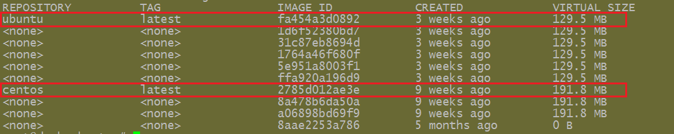
Docker Images
When we pull docker images from hub / repository, there are other images that are pulled along with it. Those are the layers of images that are part of the top level image.
$ docker pull –a <image_name> … pulls all docker images for an image name e.g. docker pull –a ubuntu.. Will pull all available versions of Ubuntu images from docker hub.
docker image
launch
docker Container
Build-time construct
Run-time construct

Slide 13

Docker Containers
Every Docker container get a writable top layer where changes to the container are done, like installing a new app, file creation, IP address changes etc.,
$ docker run –it ubuntu /bin/bash --- run a container using mentioned image, unpacks the image, layers and build a container with a terminal in interactive mode and assign a shell prompt.
$ docker run –dt ubuntu ----- run a docker container in detached mode. The container can be attached to with the command,
$ docker attach <container_ID>
Also one get attached to docker running container using command,
$ docker exec –it <docker_container_id> bash
Sample Docker Container
Metadata
Image layering
3)
2)
1)
0)…..
R / W Top layer image
One per container
Layer 2 (image) -- Application
Can be shared by many containers
Layer 1 (image) -- NGINX
Base Image (root fs)

Slide 14
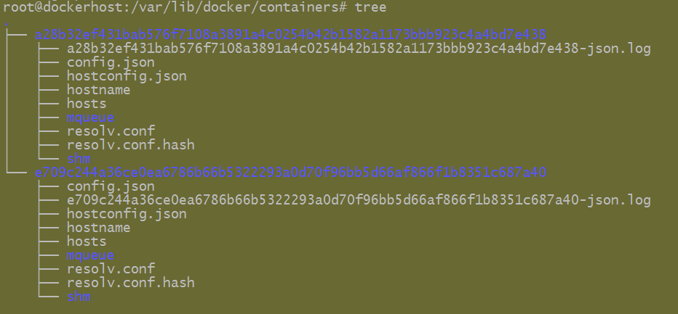
Docker Containers
Inside /var/lib/docker/container folder are the container structures.
We can create images that can be exported / shared with using the command,
$ docker commit <container ID> <image_name>
$ docker ps –a --- to list all docker container that’s been running currently and in the past.
$ docker commit e709c244a36c new_img
The image that gets created is only the top layer image with very small size that holds only the latest updates, etc.

Slide 15
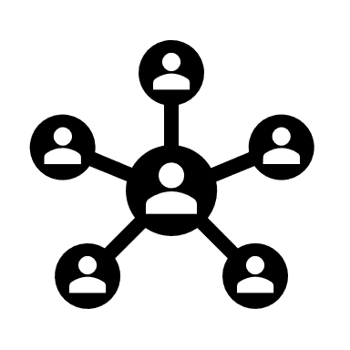
Networking containers
In Docker environment on the docker host, there’s always a default bridge network. Services from the same applications run inside one common network. For any new applications to start on the host, we create a separate new network and run apps / services inside the new network.
We can list all networks on the host by using command,
$ docker network ls
NETWORK ID NAME DRIVER SCOPE
f71a95282ed0 bridge bridge local
cc1302596540 host host local
011a0c94a404 none null local
To create a new custom network bridge interface, we can use command,
$ docker network create -d bridge mynetwork
To create a container inside a specific network, use command,
$ docker run –dt --net=mynetwork --name=generic ubuntu:latest

Slide 16
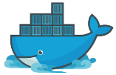
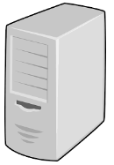
Application Containerization
portability
App
App
App
App
App
App
Container
Container
Container
Container
Container
Container
….
….
Docker Engine
Docker Engine
AWS EC2

Slide 17

DockerFile
Dockerfile: Declarative way to construct an image.
A Dockerfile is similar in concept to the recipes and manifests found in configuration management tools like Chef or Puppet.
Dockerfile is much more stripped down than the IA tools, consisting of a single file with a DSL that has a handful of instructions.
Below is sample Dockerfile that uses the ubuntu image, RUN command is used to run a certain command inside a container., ADD is used to add a file from host machine to the container and place it at desired location.
FROM ubuntu:latest
RUN apt-get update
RUN apt-get install -y python python-pip wget
RUN pip install Flask
WORKDIR /home
Images are build time constructs and Container are run time constructs.
$ docker build –t <dockerimage_name> <dockerfile_path>

Slide 18
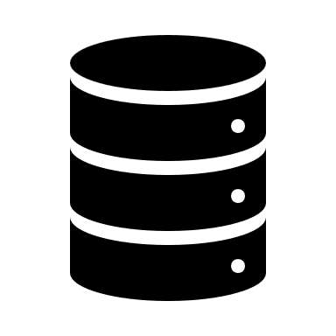
Docker registries and repos
https://registry.hub.docker.com --- docker official registry
https://hub.docker.com/ --- create account on docker hub to upload / contribute to the docker public repository.
https://store.docker.com --- image repositories.
Use $ docker pull <image_name>… command to pull images from registries.

Slide 19

Docker and Microservices
In an application there are multiple services and such services can be offered in an Docker container as a service and such container working together forms the entire application. This way, the individual service can be upgraded / maintained without imposing any downtime on the application.
Enterprise Application
Database analysis
Security
Reporting
Archival
Search and retrieval
Query analysis

Slide 20
Thank You

